Slide 1
Daily Review
Element | Symbol | Element | Symbol | Element | Symbol
Aluminium | Al | Helium | He | Nitrogen | N
Barium | Ba | Hydrogen | H | Oxygen | O
Bromine | Br | Iodine | I | Phosphorus | P
Calcium | Ca | Iron | Fe | Potassium | K
Carbon | C | Lead | Pb | Silicon | Si
Chlorine | Cl | Lithium | Li | Silver | Ag
Chromium | Cr | Magnesium | Mg | Sodium | Na
Cobalt | Co | Manganese | Mn | Sulfur | S
Copper | Cu | Mercury | Hg | Tin | Sn
Fluorine | F | Neon | Ne | Uranium | U
Gold | Au | Nickel | Ni | Zinc | Zn
Some substances cannot be made into simpler substances. These simplest substances are called ELEMENTS.
Chemistry is the study of these simplest substances and of how they chemically combine or react with each other to form more complex substances called COMPOUNDS.
In Year 9 you should have learnt the names and symbols of the following elements.

Slide 2
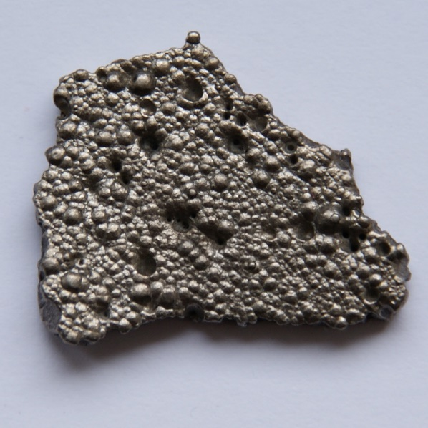

Daily Review
In Year 9 you learnt how to write the symbols for the elements
The symbol is always written e.g. Al not al.
If an element’s symbol has more than one letter, the first letter must be in CAPITALS and the others in lower case.
Many of the symbols originate from the Latin and Greek languages
e.g. Sodium (Na) and Lead (Pb).
Can you use Co and CO to explain the differences between elements and compounds?

Slide 3
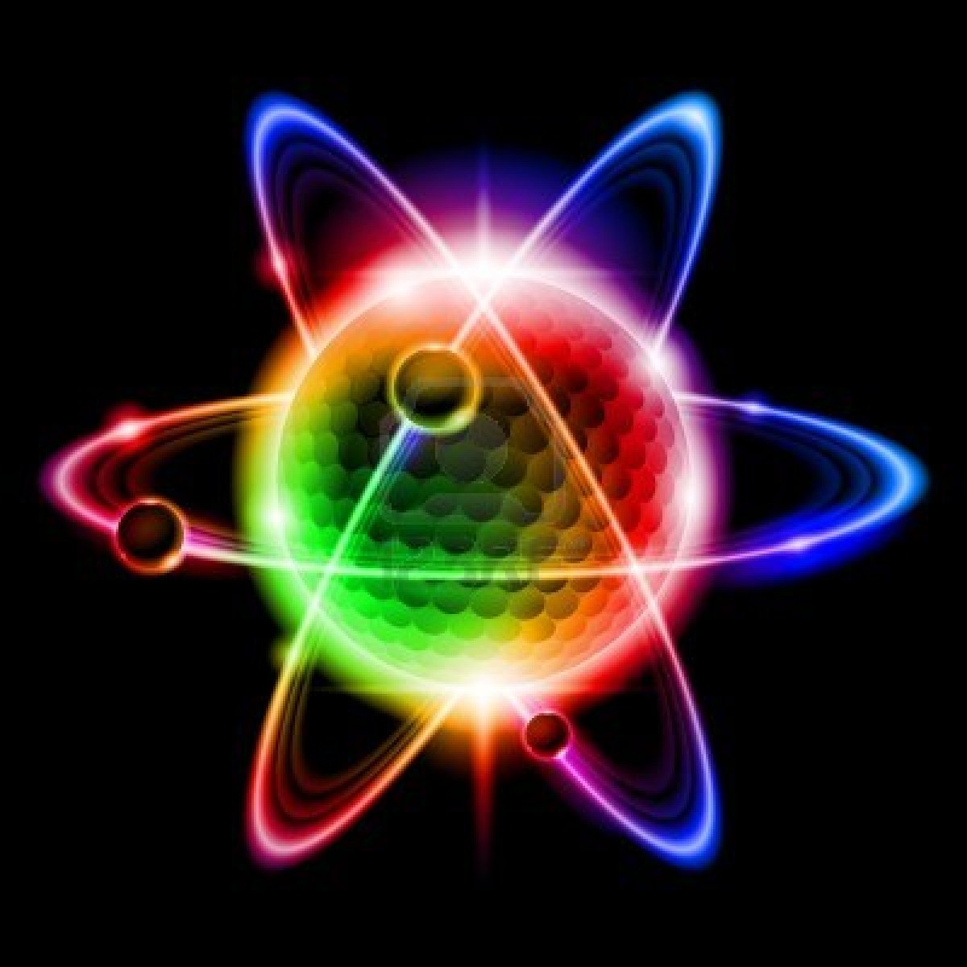
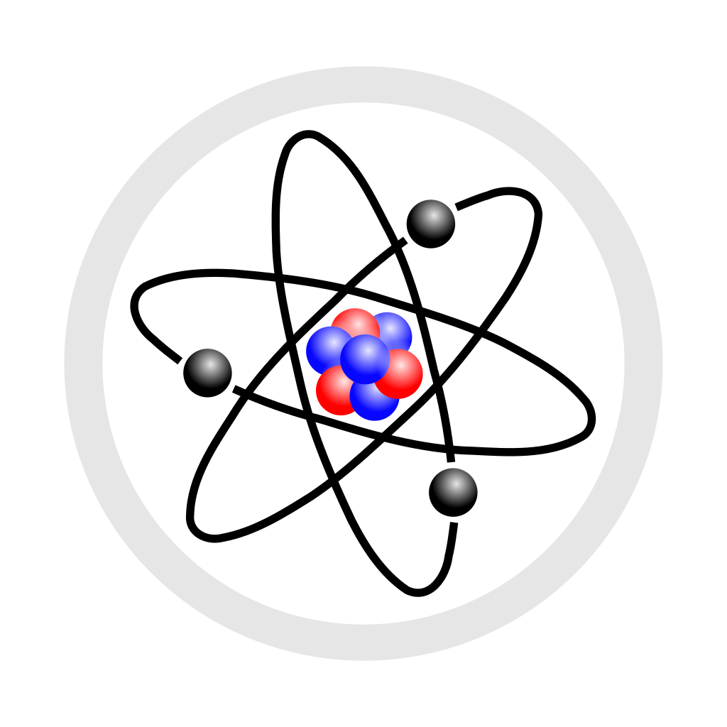
Structure of the Atom

Slide 4
Learning Objectives
CFU
What are we going to learn?
Compare charges and mass for Protons, neutrons and electrons.
Describe the composition of the nucleus and outer regions.
Define and show an understanding of Atomic number and Atomic mass.
Activate Prior Knowledge
Matter is anything that takes up space and has mass. All matter is made up of ATOMS.
Atoms are the building blocks of matter, sort of how bricks are the building blocks of houses.
An atom has three fundamental subatomic particles:
Protons – positive charge
Neutrons - no charge (neutral)
Electrons - negative charge
The proton and neutron are found in the centre of the atom, a place called the nucleus. The electrons orbit the nucleus.
CFU
What are the three particles present in an atom? What is the charge of these particles?

Slide 5

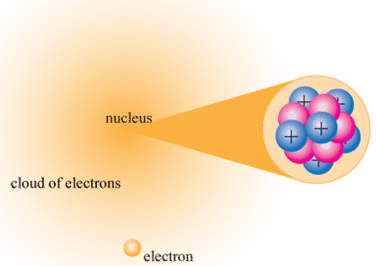
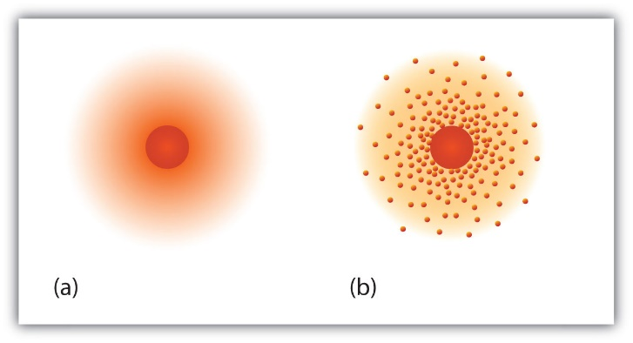
Where are the subatomic particles?
Protons and neutrons are extremely tightly packed in the centre or NUCLEUS of an atom. They are so tightly held they can only vibrate about fixed positions.
Electrons are moving in regions of space around the nucleus. Because of their extremely small size and wave-like properties it is not possible to say exactly where an electron is and how fast it is moving. Instead we describe a region of space where an electron is likely to be – this is called an ELECTRON CLOUD.

Slide 6
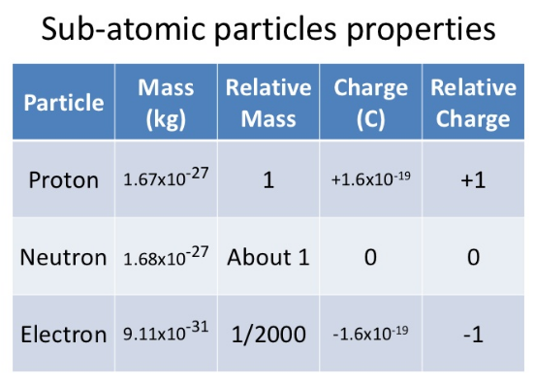
Concept Development
CFU 1
Which two subatomic particles have similar relative masses?
CFU 2
Which subatomic particle is the lightest?
CFU 3
What can you conclude about the actual mass of these subatomic particles?
The table on the left outlines the properties of each of the particles in an atom.

Slide 7
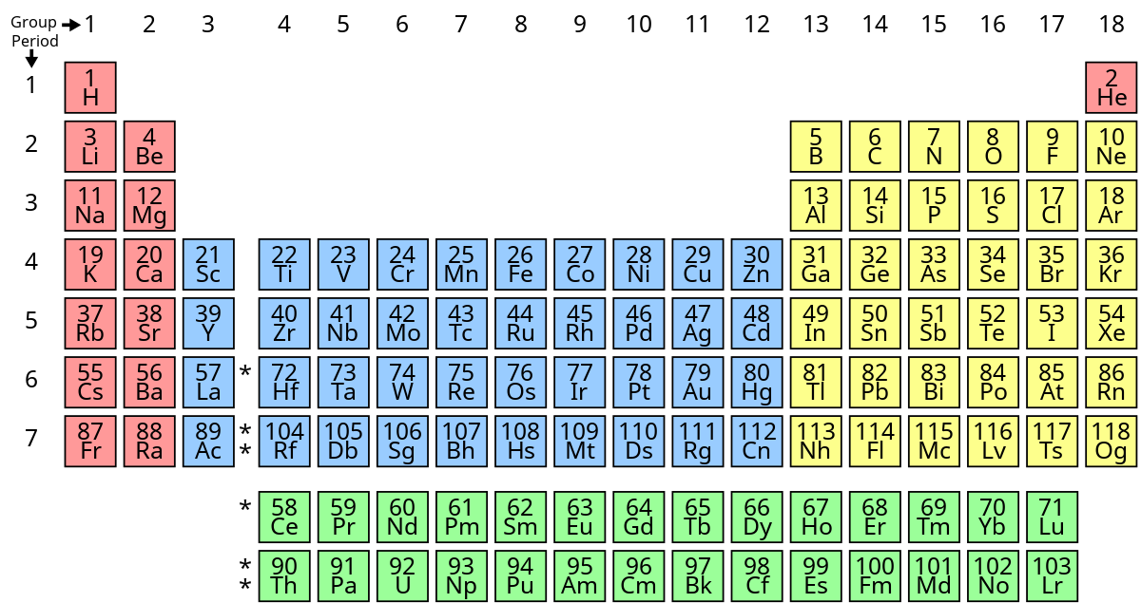
Concept Development
CFU 1
What is the name given to the following features of the periodic table? Horizontal row Vertical column
Period
A horizontal list of elements found in the periodic table.
Group
A vertical list of elements found in the periodic table that have characteristics in common.
CFU 2
How many periods and groups in a periodic table ?

Slide 8
Concept Development
CFU 1
What does the atomic number indicate? It is the number of--------
CFU 2
The atomic number is also the number of what?
CFU 3
The atomic mass is the number of _____ in an atom.
CFU 4
To find the number of electrons in an atom we would use the ________ number.

Slide 9
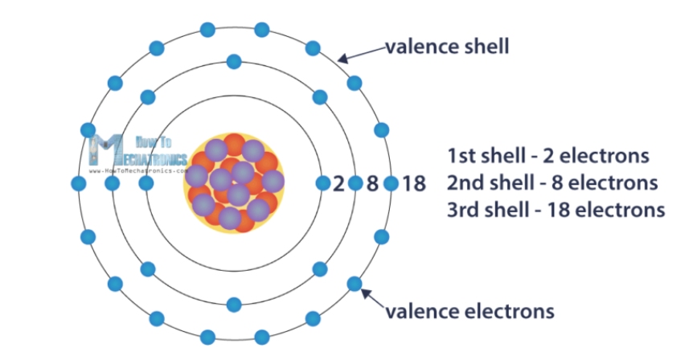
Concept Development
CFU 1
Define relative atomic mass.
Relative atomic mass
It is the sum of the number of positive protons and number of neutral neutrons.
Valence shell
The outermost electron shell is called the valence shell of the atom.
CFU 3
What is the valence shell of an atom?

Slide 10
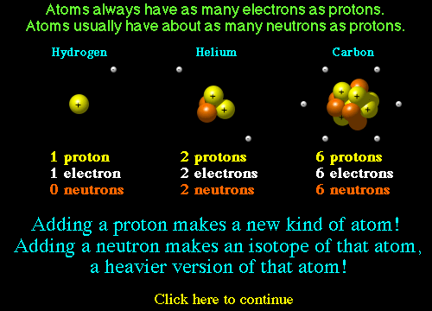
Concept Development
CFU 1
Why do neutral atoms always have the same number of electrons as protons?
CFU 2
Adding neutrons makes an _____ of that atom.
CFU 3
Which substance has no neutrons in its most common state?
CFU 4
Do ALL atoms have the same number of protons and neutrons?

Slide 11

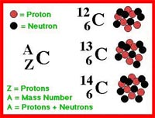
CFU 1
What is an atom with different numbers of neutrons in the nucleus called?
Concept Development
Isotopes are atoms with the same number of protons but different number of neutrons. Different isotopes are named by their mass number as they weigh a different amount (because of the different amount of neutrons they contain).
Remember: number of protons + neutrons = mass number.
CFU 2
List the difference and similarities between Hydrogen -1, Hydrogen-2 and Hydrogen-3?
All carbons have 6 protons
C-12 has 6 neutrons
C-13 has 7 neutrons
C-14 has 8 neutrons
CFU 3
Why do isotopes of the same element weigh different amounts?
CFU 4
If the protons of an atom change, do you still have the same substance (element) ?

Slide 12
Skill Development/Guided Practice
Reminder
Atomic Number
Symbol
Atomic Mass
Describing atomic symbols
Identify the element, atomic number, and atomic mass. From this, identify the number of protons, number of electrons and number of neutrons
Element = Zinc
Atomic number = 30
Atomic Mass = 66
Number of protons = 30
Number of electrons = 30
Number of neutrons = 36
66
Zn
30

Slide 13
Skill Development/Guided Practice
Reminder
Atomic Number
Symbol
Atomic Mass
Describing atomic symbols
Identify the element, atomic number, and atomic mass. From this, identify the number of protons, number of electrons and number of neutrons
Element = Helium
Atomic number = 2
Atomic Mass = 4
Number of protons = 2
Number of electrons = 2
Number of neutrons = 2
2
He
4

Slide 14
Skill Development/Guided Practice
Describing atomic symbols
Identify the element, atomic number, and atomic mass. From this, identify the number of protons, number of electrons and number of neutrons
Element = Iron
Atomic number = 26
Atomic Mass = 56
Number of protons = 26
Number of electrons = 26
Number of neutrons = 30
56
Fe
26

Slide 15
Skill Development/Guided Practice
Describing atomic symbols
Identify the element, atomic number, and atomic mass. From this, identify the number of protons, number of electrons and number of neutrons
Element = Sodium
Atomic number = 11
Atomic Mass = 23
Number of protons = 11
Number of electrons = 11
Number of neutrons = 12
23
Na
11

Slide 16
Skill Development/Guided Practice
Describing atomic symbols
Identify the element, atomic number, and atomic mass. From this, identify the number of protons, number of electrons and number of neutrons
Element = Magnesium
Atomic number = 12
Atomic Mass = 24
Number of protons = 12
Number of electrons = 12
Number of neutrons = 12
24
Mg
12

Slide 17
Skill Development/Guided Practice
Describing atomic symbols
Identify the element, atomic number, and atomic mass. From this, identify the number of protons, number of electrons and number of neutrons
Element = potassium
Atomic number = 19
Atomic Mass = 39
Number of protons = 19
Number of electrons = 19
Number of neutrons = 20
39
K
19

Slide 18
Relevance
The atomic symbol represents the number of protons, neutrons, and electrons in an element.
This relates to properties of elements, which allows you to understand how the different properties decides how they are used.
All matter is made up of atoms and atoms make elements unique.
For a long time it's been a mystery how these elements are made. Most of the stuff in the universe is made of light gaseous elements like hydrogen and helium. Medium weight elements like iron and aluminium are produced when massive stars explode.
Atoms are everywhere, Elements are everywhere. The periodic table is everywhere! Matter is everywhere!
So the study of atoms is extremely relevant to all matter, which is everywhere.

Slide 19
Skill Closure
Draw an atom of carbon showing the protons, neutrons, and electrons. Don’t erase!
Skill Closure
Underneath the drawing, show what the two isotopes of carbon C-13 and C-14 would look like.
Skill Closure
Describe the difference between the atomic number, atomic mass, and isotopes.

Slide 20
Independent Practice
 | Element | Z Atomic number | A Atomic mass | Number of protons | Number of neutrons
12 C 6 | Carbon | 6 | 12 | 6 | 6
35 Cl 17
40 Ca 20
 | chromium | 24 | 52
Cs | caesium |  |  | 55 | 78
 | copper |  | 64 | 29
Cm | curium | 96 |  |  | 151
Cd | cadmium | 48 | 112
Cf | californium | 98 | 251
In your exercise book:
1. Write the date and the title “Atoms”
2. Define the terms atomic number, atomic mass, and isotopes.
3. Draw and Complete the following table. (6 x 10) – the first one has been done for you.
Rafflesia
Cactus
Jasmine
Bottlebrush

Slide 21
4. Name the following elements - He, Mg, Ba, P, Si, Co, Li, N, Fe, Hg.
5. Give the symbols of the following elements- Lead, Carbon, Chlorine, Potassium, Gold, Sodium, Tin, Iodine, Chromium.
6. State if each of the following statements is true or false. If they are false, alter the statement so that it becomes true.
a) Protons and neutrons have approximately the same mass.
b) In a neutral atom, the number of protons equals the number of neutrons.
c) The mass of an electron is one hundredth the mass of a proton.
d) The nucleus contains protons and neutrons.
e) The atom is mostly empty space.
f) Most of the mass of the atom exists in the electron cloud.
g) An element is the simplest substance. It cannot be broken down into simpler substances by chemical reactions.
h) A compound contains 2 or more elements mixed together.

Slide 22
Answers
 | Element | Z Atomic number | A Atomic mass | Number of protons | Number of neutrons
12 C 6 | Carbon | 6 | 12 | 6 | 6
35 Cl 17 | Chlorine | 17 | 35 | 17 | 18
40 Ca 20 | Calcium | 20 | 40 | 20 | 20
52 Cr 24 | chromium | 24 | 52 | 24 | 28
133 Cs 55 | caesium | 55 | 133 | 55 | 78
64 Cu 29 | copper | 29 | 64 | 29 | 35
247 Cm 96 | curium | 96 | 247 | 96 | 151
112 Cd 48 | cadmium | 48 | 112 | 48 | 64
251 Cf 98 | califonium | 98 | 251 | 98 | 153

Slide 23
Answers
Q4 – Name the following elements – He = Helium, Mg = Magnesium, Ba = Barium, P = Phosphorus, Si = Silicon, Co = Cobalt, Li = Lithium, N = Nitrogen, Fe = Iron, Hg = Mercury.
Q5 Give the symbols of the following elements- Lead = Pb,
Carbon = C, Chlorine = Cl, Potassium = K, Gold = Au, Sodium = Na, Tin = Sn, Iodine = I, Chromium = Cr
Q6-
a) T | b) F electrons instead of neutrons | c) F 1/2000 or more correctly 1/1893 | d) T
e) T | f) F nucleus instead of electron cloud | g) T | h) F chemically combined instead of mixed

